Slide 1



What is CrixFolio?
Crixfolio is World’s first Index fund powered by artificial intelligence with blockchain technology through Smart Contracts.
"You will almost never find a fund manager who can repeatedly beat the market. It is better to invest in an indexed fund that promises a market return but with significantly lower fees.“ … John Bogle
AI
Blockchain
CrixFolio
Cryptofolio30 will offer a diversified collection of cryptocurrencies and cryptoassets that will trade on an exchange and represent a passive investment vehicle and mining in crypto economy.
It is the unique combination of AI and Blockchain which makes it different from other market players which are purely driven by rule based criterias.
We will use the amount raised in ICO to buy the underlying top 30 assets driven by AI algorithms & insights

Slide 2
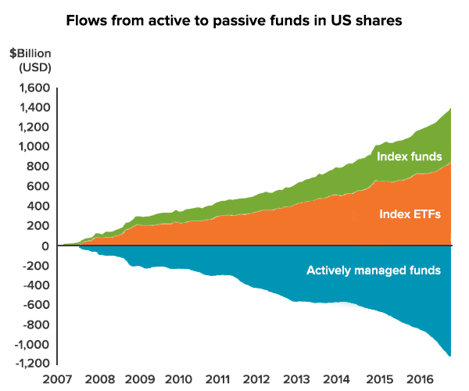
Why Index fund?
Index funds are constantly outperforming
Actively managed funds.
In the last ten years Passively managed funds
Shrunken by 1000 Billion and at the same time
Actively managed funds rises by 1600 Billion
CrixFolio Features
Blockchain transparency
Powered by AI
Low Cost
No exit fees
No minimum investment
Easy to track NAV
Credit Suisse

